Slide 1
Economics 1
Introduction to Economics

Slide 2
My Introduction
Instructor: Jason Lee
Email: jlee287@ucmerced.edu
Office: 376 COB
Office Hours: Monday and Thursdays (9:15-10:15am) and Wednesdays (9:15-11:15am)
Course Webpage: UCMCROPS (course syllabus is located here)

Slide 3
I. What is Economics?
Definition: Economics is the study of how society makes decisions in a world of scarcity.
We live in a world of infinite wants but finite goods and resources.
Economics answers the question of who gets which goods and in what amounts.

Slide 4
II. Microeconomics vs. Macroeconomics
The Two Divisions of Economics:
Microeconomics
Microeconomics is the study of decision making behavior of individual decision making units (Households, firms, industries, etc…)
(2) Macroeconomics
Macroeconomics is the study of the aggregate (total) economy.

Slide 5
II. Microeconomics vs. Macroeconomics
The two disciplines look at the same issues but from a different vantage point.
Example: Looking at production
Micro Question: How many hamburgers does In N’ Out produce in a year?
Macro Question: How many total goods and services does the U.S. economy produce in a year?

Slide 6
II. Microeconomics vs. Macroeconomics
Example: Looking at Prices
Micro Question: What is the price that In N’ Out charges for its burger? How does In N’ Out decide what price to charge for its burger?
Macro Question: What is the average price level for all goods and services in the economy? What factors determine the overall price level?

Slide 7
II. Microeconomics vs. Macroeconomics
Example: Looking at Employment
Micro Question: How many workers are employed by In N’ Out? How does the firm determine how many workers to hire?
Macro Question: How many workers are employed in the economy? What factors affect the unemployment rate?

Slide 8
III. Why Study Microeconomics?
Studying microeconomics allows us to develop a new way of thinking on how individuals and firms make decisions.
It will improve your ability to make decisions in almost all aspects of your everyday life.

Slide 9
IV. Why Study Macroeconomics?
Macroeconomics plays such an important role in our everyday lives. The unemployment rate will affect your ability to find a job after college. Interest rates will affect your ability to purchase your first car or your first home.
Macroeconomics is at the heart of political debates. Decisions made by policymakers have an important impact on our everyday lives.

Slide 10
V. Key Principles of Economics
1. Opportunity Costs
All decisions involve trade-offs.
Definition: Opportunity cost measures the cost of the next best alternative that we give up when making a choice.
Opportunity cost can vary from individual to individual

Slide 11
V. Key Principles of Economics
For the following choices see if you can determine what the potential opportunity costs are. Remember that opportunity costs can differ from individual to individual.
(a) Choice: Attending College
Choice: Attending Econ 1 at 7:30 am
Choice: Cutting the Government budget deficit

Slide 12
V. Key Principles of Economics
Rational people make decisions at the margin.
A rational person makes decisions based on achieving some desired objectives and takes into account all available information when making their decision.
Example: A business owner might have an objective of maximizing profits. The owner is said to act rationally if the decisions he/she makes will result in higher profits.

Slide 13
V. Key Principles of Economics
Key Point: When making a decision a rational person should only consider the additional costs or benefits (and not the total) that will arise from that decision.
Two terms
Marginal Cost: The additional cost that will result from a decision
Marginal Benefit: The additional benefit that will result from a decision

Slide 14
V. Key Principles of Economics
Example: Factory owner trying to decide whether or not to hire an additional worker.
Suppose that the owner pays each of his workers $50 a day. Thus if he hires this worker he will have to pay that worker $50.
What is the marginal cost to the factory owner if he decides to hire this worker?

Slide 15
V. Key Principles of Economics
Suppose that the factory owner also knows that by hiring the worker, that the worker will produce $60 worth of goods for the factory.
What is the marginal benefit to the factory owner if he decides to hire this worker?
Should the factory owner hire this additional worker?

Slide 16
V. Key Principles of Economics
Yes since the marginal benefit of hiring an additional worker exceeds the marginal cost of hiring that worker.
Note that the decision did not depend on the total number of workers already hired or the total wages already paid or the total output already produced. All that mattered was the additional (or marginal) cost and benefit associated with that additional worker.

Slide 17
V. Key Principles of Economics
Example: Suppose that you have a 2001 Toyota Corolla that you can currently sell for $4000. If you replace the car engine you can sell the car for $4800 instead of $4000.
Suppose the cost to replace the car engine is $900.
Q: Should you replace the car engine?

Slide 18
V. Key Principles of Economics
Rational People Respond to Incentives
The decisions made by rational individuals are influenced by incentives (both good and bad).
Example: An individual who is deciding how many cigarettes to purchased will be influenced by price. If the price of cigarettes increases this will be a powerful incentive to purchase less cigarettes. Conversely if the price decreases this will be an incentive to purchase more cigarettes.
The government knows that prices are a powerful incentive that affect consumption decisions. They often impose taxes on “bad” goods to persuade consumers to change their behavior and will often impose subsidies on “beneficial” goods to persuade consumers to purchase more of a product.

Slide 19
V. Key Principles of Economics
4. Trade Can Make Everyone Better Off
Trade occurs because it makes both parties of the trade better off. Why would you voluntarily trade if you would be worse off?
Without trade individuals would have to be self sufficient.
Individuals will specialize in producing goods in which they have an advantage in producing. They will trade some of their specialized good for other goods and services they want. Allow them to consume more than if they were self sufficient.

Slide 20
V. Key Principles of Economics
5. A Market Economy is Usually the Best Way to Organize Economic Activity
Every economy must answer certain basic questions:
What goods get produced?
How much of the good gets produced?
Who will produce the good?
Who will receive the good produced?

Slide 21
V. Key Principles of Economics
A market economy is an economy where the above questions are answered by the individual decision making of millions of individuals and firms.
An alternative way to answer the basic economic questions is to have a central planner (usually the government) decide. The central planner goal is to maximize society’s well being.
Given the choice between a market economy and a centrally planned economy, the market economy is the best way to organize economic activity.

Slide 22
V. Key Principles of Economics
6. Government Can Improve Market Outcomes
Although governments are not the best way to answer the basic economic questions, there is certainly a role for government in organizing economic activity.
Generally, market economy will lead to an outcome that will maximize social welfare, however this will not always be the case.

Slide 23
V. Key Principles of Economics
Sometimes the market economy will lead to an outcome of overproduction or underproduction of a good than what is socially optimal. When this occurs it is called a market failure.
When market failure occurs, the government can and should play a role by providing incentives in the form of taxes and subsidies to get firms or consumer to produce or consume the socially optimal amount.

Slide 24
V. Key Principles of Economics
7. Differences in Income per Person Depends on Worker Productivity
Country | Income per Person (2004 U.S. $)
United States | $39,710
Germany | $27,950
Mexico | $9,590
Brazil | $8,020
China | $5,530
Pakistan | $2,160
Nigeria | $930

Slide 25
V. Key Principles of Economics
Question: Why is there a disparity among countries in terms of average income?
Answer: Differences exist because of differences in worker productivity. A worker in a rich country (United States) can produce more output in a day than a worker in a poor country (Nigeria)

Slide 26
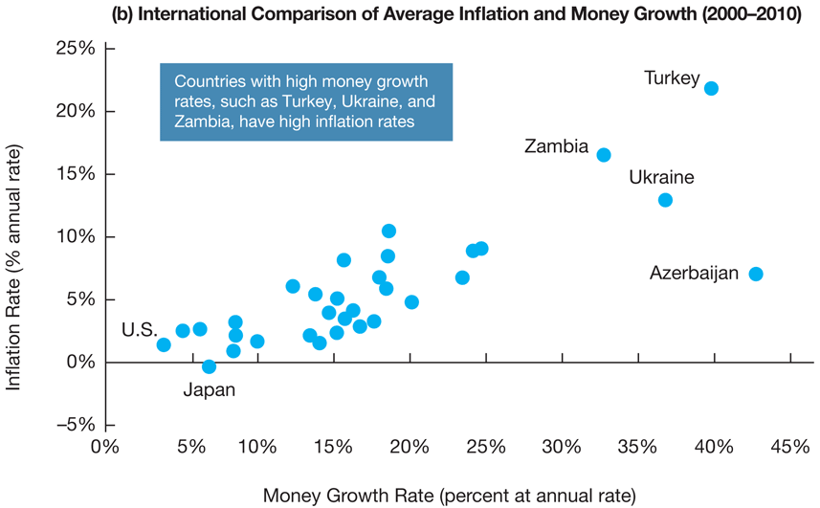
V. Key Principles of Economics
8. Inflation Occurs When the Government Prints Too Much Money

Slide 27
V. Key Principles of Economics
Key Point: The reason for persistent inflation is the continuous increase in the nation’s money supply. When the government prints large amounts of money and releases it in the economy, prices will increase.

Slide 28
V. Key Principles of Economics
Society Faces a Short-Run Tradeoff Between Inflation and Unemployment
The ideal situation for policymakers would be a world with low inflation and low unemployment.
Unfortunately that ideal situation rarely occurs. Policymakers must make a choice:
If they choose low inflation they must accept high unemployment.
If they choose low unemployment they must accept high inflation.

Slide 29
V. Key Principles of Economics
Inflation rate (% per year)
68
66
67
62
65
1961
64
63
Unemployment rate (%)
Notes:
The data almost perfectly trace out a downward-sloping Phillips curve.
But what’s important here is not just the negative slope, but the economy’s movement over the years:
Fiscal policy was expansionary, in part to finance the Vietnam war. To keep interest rates low, the Fed made monetary policy expansionary as well. As a result, aggregate demand grew over the 1960s.
You can see this if you follow the points year by year: inflation gradually creeps up while unemployment is falling, which is exactly what was depicted on the graphs we used to derive the Phillips curve.

Slide 30
VI. Other Key Issues in Macroeconomics
What key factors explain long-run economic growth?

Slide 31
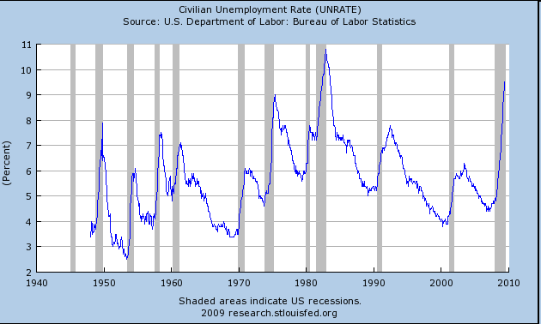
VI. Other Key Issues in Macroeconomics
Why do we have unemployment?

Slide 32
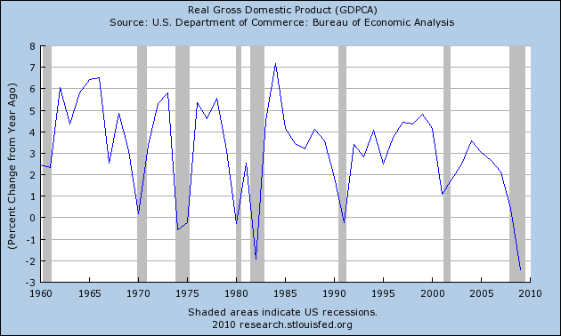
VI. Other Key Issues in Macroeconomics
3. Why do we have short-run fluctuations in the Economy?

Slide 33
VI. Other Key Issues in Macroeconomics
What can Policymakers do to Combat Economic Fluctuations in the Economy?
Policymakers have two sets of tools to fight inflation: (1) fiscal policy and (2) monetary policy.
Definition: Fiscal policies are policies that involve changes in government spending or tax policy.
Definition: Monetary policies are policies that involve changes in the money supply.

Slide 34
VII. Positive vs. Normative Economics
Economists must answer a lot of questions. The answers to these questions can fall into two categories:
Positive Economics: Approach to economics that seeks to understand behavior of the economic system without making judgments. It describes what exists and how it works.
Normative Economics: Approach to economics that analyzes outcomes of economic behavior and evaluates them as good or bad. May make recommendations.

Slide 35
VII. Positive vs. Normative Economics
Raising the minimum wage will lower employment opportunities for high school age workers.
We should raise the minimum wage to get low income families out of poverty.

